Slide 1

Employee Attrition case study by: titus karuri

Slide 2

Case study
Frito Lay has hired us to create models that predict employee attrition and to identify factors that are related to the attrition so that it will give them information on how to reduce the chances of attrition happening.
Industry estimates suggest that replacing an employee costs between 50% to 200% of their annual salary.

Slide 3
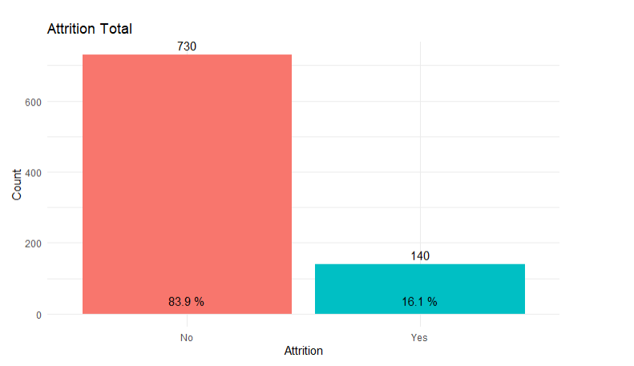
Attrition count
Total number of Attrition is 140 and non-Attrition is 730.

Slide 4
Factors for attrition
Original factors decided were Job level, Job satisfaction, Years at a company, and Monthly Income.
Further testing revealed some factors weren’t needed.
New list is Job Level, Years At Company, Age, and Monthly Income.
Discuss reasonings in later slides.

Slide 5
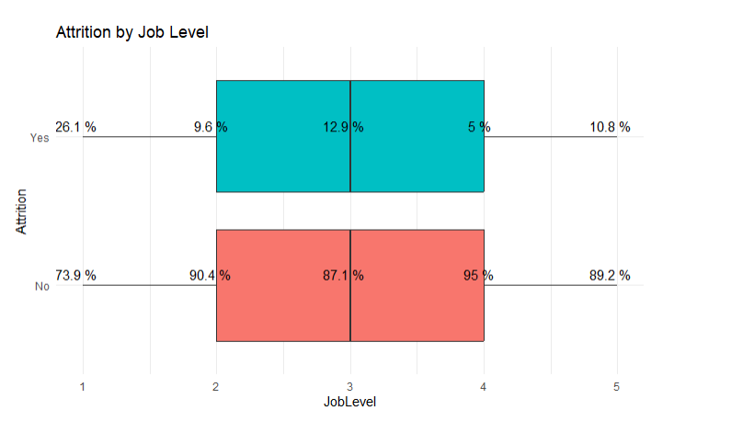
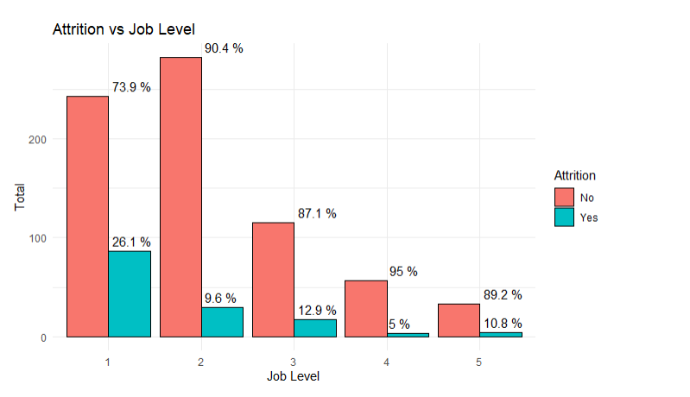
Job level analysis
Employees at lower job levels are more likely to leave.
Higher job level more likely to stay.
Most employees who left the company were in that 1 to 3 level in their job role.

Slide 6
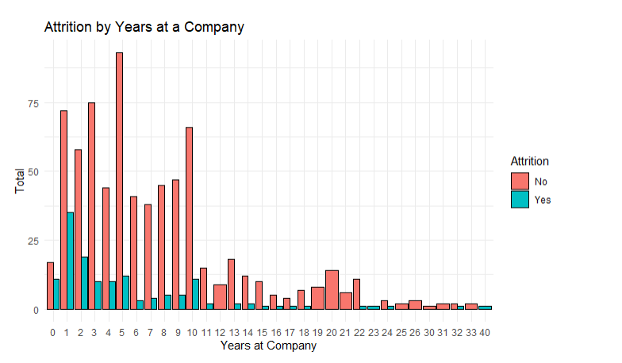
Years at a company
Employees starting out haven’t built a sense of loyalty to a company.
Newer employees aren’t fully engaged in company culture.

Slide 7
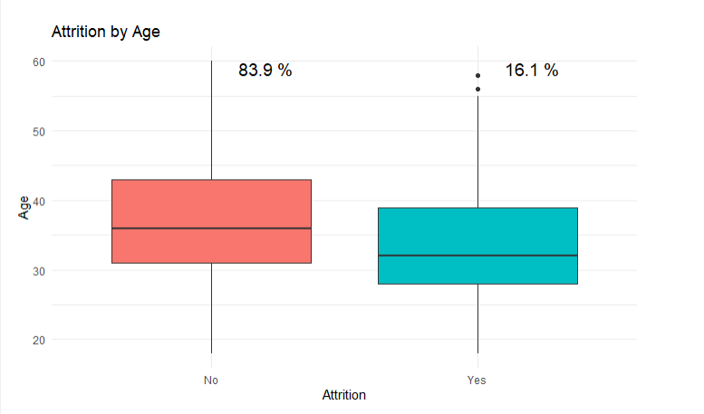
Age analysis
Younger employees are more likely to switch jobs for several factors.
Better opportunities
Higher salary
Older employees are more inclined to stay.

Slide 8
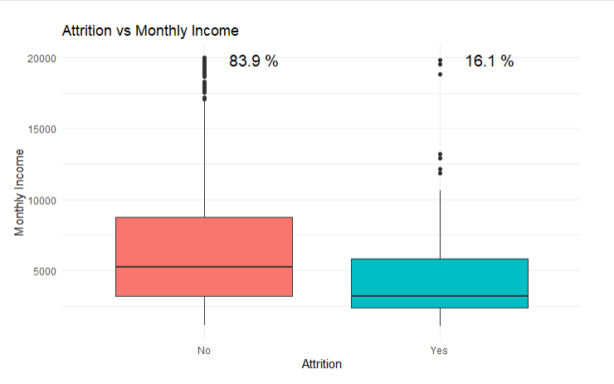
Monthly Income analysis
Median income is lower for employees who leave.
Higher income could lead to lower Attrition.

Slide 9
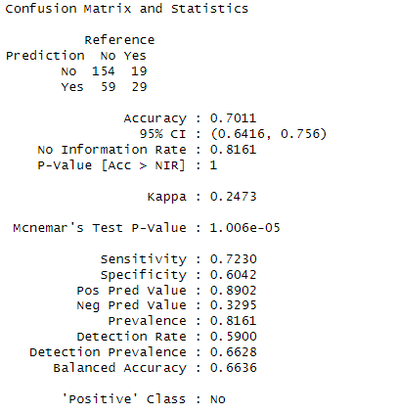
Naïve baye model
Average of 1000 runs.
Model was built based on the major factors chosen.
Split the data into 70% training and 30% testing.
To calculate savings. Savings = (True Positive × Retention Rate × Cost per Employee)
Assume company retains 30% of correctly predicted attrition cases
Assume cost per employee is $60,000
Total potential savings is $2,772,000

Slide 10
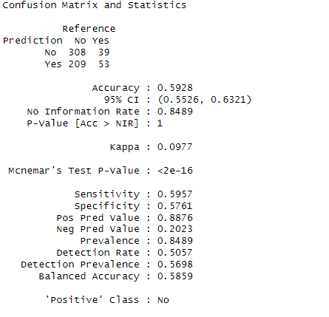
Knn model
Used entire data set for training and testing cross validation, so the results are the averages of multiple train test splits.
Same calculations . Savings = (True Positive × Retention Rate × Cost per Employee).
Again, assume company retains 30% of correctly predicted attrition cases
Average employee salary is $60,000
Total potential savings is $5,544,000

Slide 11
Closing
Based on the analysis done for these models. Those major factors seem to be correct in predicting the chances of attrition.
Naïve Baye model provided better sensitivity and specificity.
Apply better retention methods to lower the amount of Attrition that could happen.
Have Frito Lay perform more intervention methods for disgruntled employees.

Slide 12

THANK YOU
Titus Karuri
tkaruri@smu.edu

